Slide 1

UNIX SHELL PROGRAMMING
THE PROCESS
PREETHI.P
Department of Computer Science and
Engineering

Slide 2

UNIX SHELL PROGRAMMING
THE PROCESS
PREETHI.P
Department of Computer Science and Engineering

Slide 3
UNIX SHELL PROGRAMMING
BASICS OF PROCESS
Running program is called a process.
A process is born when it starts execution----→ remain alive as long as program is active
Process dies with the completion of execution.
It has name, states and also occupy memory

Slide 4
UNIX SHELL PROGRAMMING
BASICS OF PROCESS
Kernel manages the processes, determines time and priorities.
Schedules each process some finite amount of time.
Kernel sometimes store pages of these process in swap area of the disk.
Note: Switching happens in fraction of second.

Slide 5
UNIX SHELL PROGRAMMING
BASICS OF PROCESS
Process do have attributes : Stored in Process table.
Attributes of the process are Process id and Parent process id.
Process – id(PID) : Process is uniquely identified by an unique integer allocated by kernel, when it is born.
The Parent PID (PPID): PID of the parent.
Other attributes are inherited by the child from parent.

Slide 6
UNIX SHELL PROGRAMMING
BASICS OF PROCESS
Process can go crazy and multiply and also make your system not responding and stand still.
A process may complete and release the resources.
A process may not complete in expected time→ then you may decide to kill, suspend, move to run in background.
In this chapter will learn about what are the associated command with process and its operations.

Slide 7
UNIX SHELL PROGRAMMING
SHELL PROCESS
Kernel sets up a process as soon as we log in. this represents a Unix command ‘sh’, ‘ksh’, ‘csh’ or ‘bash’.
Shell process takes any command we key in in the terminal as standard input. Logging out kills the shell process.
The shell and its environment:
‘echo PATH’ ‘echo SHELL’ ‘echo $$’

Slide 8
UNIX SHELL PROGRAMMING
PARENTS AND CHILDERN
Every process has parent and it is another process.
When we run command ‘ls’ from keyboard, Process representing the ‘ls’ command is started by the shell process. This ‘ls’ process is active until it is active and bash is said to be the parent of ‘ls’ and ‘ls’ is the child of bash.
Note: In my system bash is the shell, it can also be replaced with the shell available in your system.

Slide 9
UNIX SHELL PROGRAMMING
PARENTS AND CHILDERN
Every process has a parent and No orphaned process.
The ancestry of every process is the first process having pid 0.
A parent can have multiple children
Ex: ls –l file.txt | grep ‘Aug’
Both the process ls and grep are the children of shell.

Slide 10
UNIX SHELL PROGRAMMING
WAIT OR NO WAIT
Two attitudes of parent towards child.
It may wait for the child to die so that it can generate the new process. The death is informed by the kernel.
It may not wait for the child to die at all and it may spawn next process. This is what the ‘init’ process does.
Note: All commands does not set up the processes.

Slide 11
UNIX SHELL PROGRAMMING
PROCESS STATUS
COMMAND – ‘ps’ display the process attributes.
This command reads to the kernel’s data structures and process table to fetch the attributes.
Command ps display PID, controlling terminal -TTY , cumulative process time - TIME and NAME of the Command (process name).

Slide 12
UNIX SHELL PROGRAMMING
COMMAND – ‘ps’
1. “ps -f” : Full Listing : lists UID, PID, PPID, C, STIME, TTY and CMD.
UID, PID, PPID, C, STIME, TTY , TIME, CMD.
x , 367, 291, 0, 12:35 , console, 0:00, vi txt
x , 291, 1 , 0, 10:35 , console, 0:00, bash
PPID : 1 ?
PPID : 0 ?
Is full listing a boon or a bane?

Slide 13
UNIX SHELL PROGRAMMING
COMMAND – ‘ps’
2. “ps – u” : Displaying the processes of user
3. “ps –a” : All user processes
4. “ps –l ” : Long listing with memory related information.
5. “ ps –t “ : list processes on the specified terminal

Slide 14
UNIX SHELL PROGRAMMING
SYSTEM PROCESSES
Processes that keep running all the time and not associated with any terminal are called system processes.
Generated during system startup and during multi user state.
Command : “ps –e or ps -A”
How to identify the system process ?
“ps –e” and if tty is ? Generally do not have a controlling terminal.

Slide 15
UNIX SHELL PROGRAMMING
SYSTEM PROCESSES
Can be interrupted using Ctrl-C ?
They are also called as ?-----------------
They are actually sleeping and wakes up -----------------
Ex:
The lpsched→ Controls all printing activities.
The sendmail→ handles incoming and outgoing mails.
The inetd→ FTP and TELNET
The cron→ looks at control file at decided time

Slide 16
UNIX SHELL PROGRAMMING
PROCESS CREATION
FORK, EXEC AND WAIT are the system calls or functions
Fork:
creates a copy of the process that invokes it.
new process image is practically identical – as calling process.
Except PID as child gets a new PID.

Slide 17
UNIX SHELL PROGRAMMING
PROCESS CREATION
EXEC:
Forked child creates a process but copies the same image as parents code.
To run a new program with new code and data --- Childs image is overwritten and the child is said to be exec.
No new process is created and holds same PID and PPID.
WAIT:
The parent uses wait system call to wait for child’s execution.

Slide 18
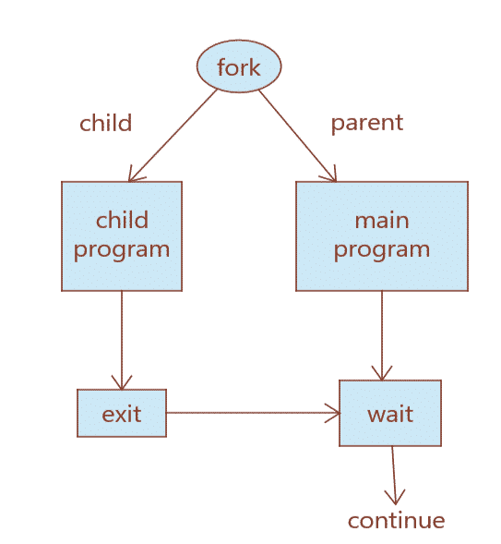
UNIX SHELL PROGRAMMING
PROCESS CREATION

Slide 19
THANK YOU
PREETHI.P
Assistant Professor , Department of Computer Science
preethip@pes.edu

